Slide 1
Note 10 Disk Storage and File Structures
CSC134
Dr. Haiquan Chen

Slide 2
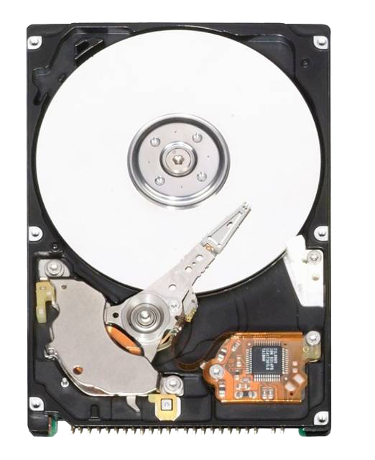
Hard disk
Hard disk is today’s most widely used device to store a database
Three reasons to use hard disk:
Data are too large to fit in memory
Disk is non-volatile storage media while memory is volatile.
Cost of disk is much cheaper than the memory
In disk, data are stored on magnetic disk surfaces

Slide 4
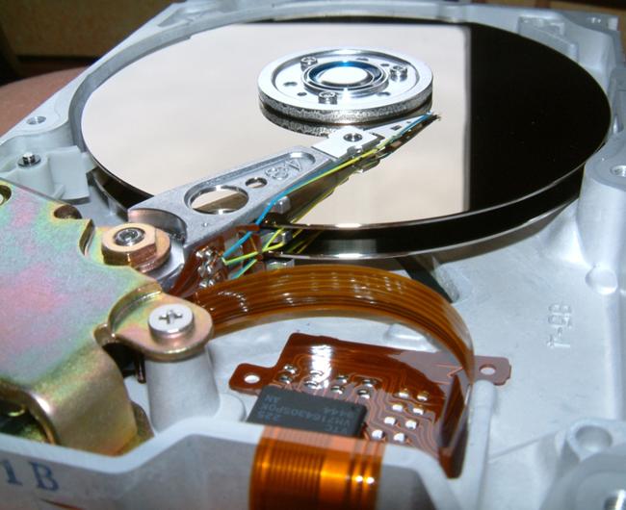
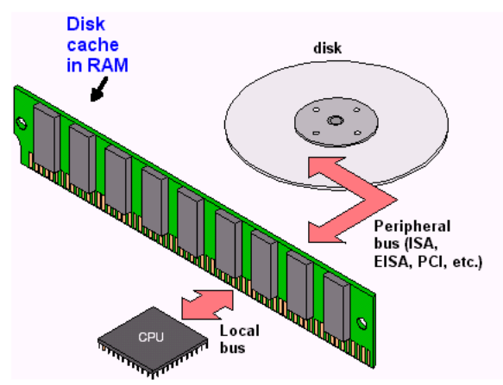
Hard Disk Devices
Disks rotate around a fixed spindle.
The disk surface is divided into circular tracks.
A track is divided into sectors (0.5KB) and
blocks (from 0.5KB to 4KB).
Sectors are set when the disk is made
Blocks are set by OS during disk formatting
Blocks are the smallest unit for data transfer between main memory and disk.
Whole blocks must transferred between disk and main memory.

Slide 5
Disk I/O Cost
How to read or write a block ?
Seek time (mechanical): A read-write head moves to the track that contains the block.
Rotational delay (mechanical): Disk rotates to move the block under the read-write head.
Data transfer time (electronic): Disk starts data transfer
Total time = Seek time (s) + Rotational delay (rd) + Data transfer time (t)
Reading or writing a block is time consuming due to the seek time and rotational delay are mechanical.

Slide 6
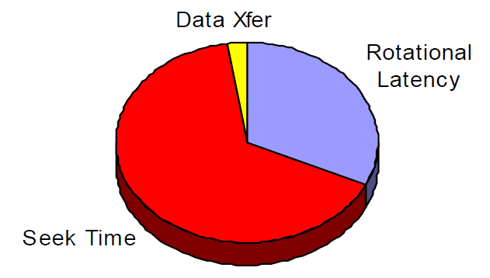
Disk I/O Cost
Components of each block access

Slide 7
A video on disk structure

Slide 8
Storing databases on disk
A relation/table in a relational database is stored as a physical file on disk
A file is a sequence of records (tuples).
Since a file/table contains more than one record, how can we arrange all the records in a file?

Slide 9
How data records are arranged in a file?
To store any file, we must map data records to disk blocks. This is called file blocking.
Blocking factor refers to the max number of records we can put into a block
Given the data file EMPLOYEE(SSN, FNAME, LNAME, ADDRESS, ... )
Suppose that:
record size R=150 bytes; block size B=512 bytes, r=30000 records
Then, we get:
blocking factor Bfr = rounddown(B / R) = 512 / 150= 3 records/block
number of file blocks = roundup(r/Bfr)= (30000/3)= 10000 blocks
Three file organizations:
Unordered Files
Ordered Files
Hashed Files

Slide 10
Unordered Files
Records are placed in the order in which they are inserted/arrived.
A linear search through the file records is necessary to search for a record.
This requires searching half the file blocks on average, and is hence quite expensive.
Record insertion is quite efficient.

Slide 11
Ordered Files
Records are sorted by the values of a particular field.
A binary search can be used to search for a record on its ordering field value.
This requires searching log₂ of the file blocks on average, a big improvement over linear search.
Insertion is expensive. Why?
Records must be inserted in the correct order. To make space, on average, half of file blocks should be moved (i.e., rewritten)

Slide 12
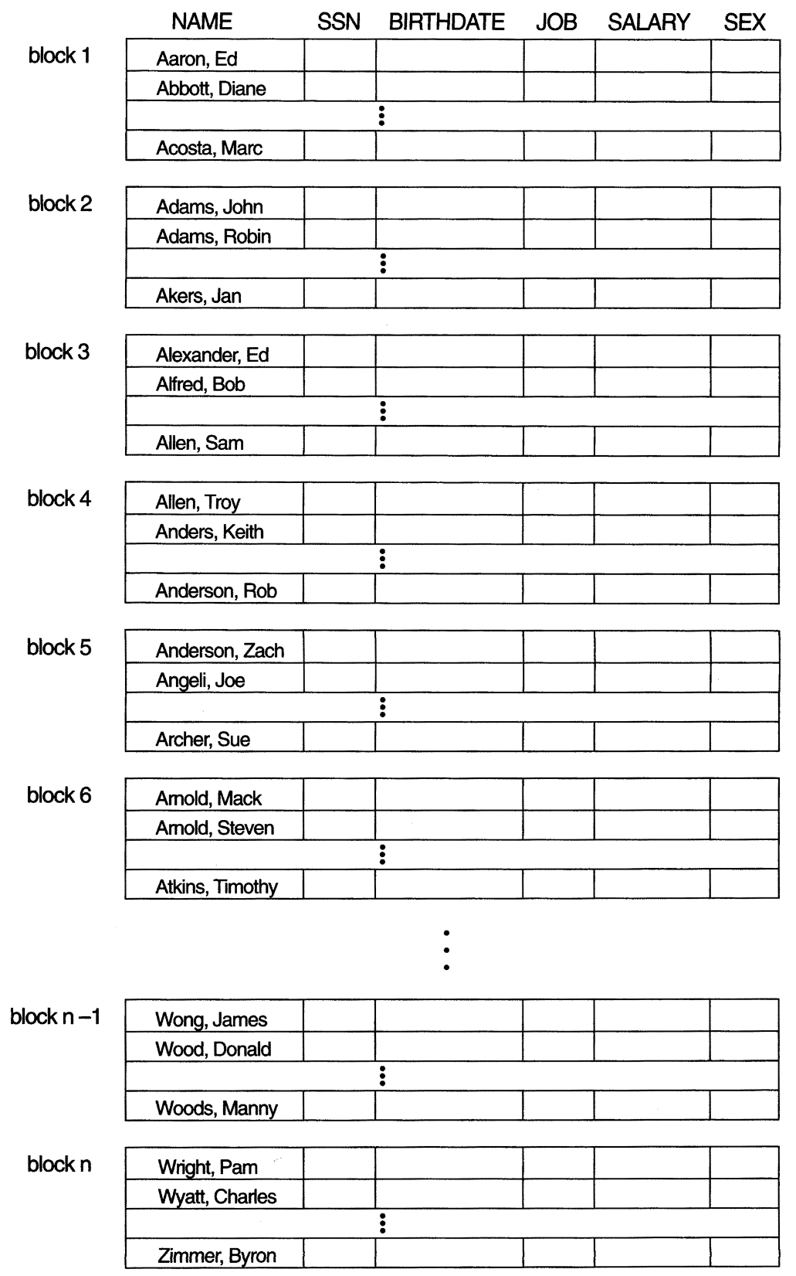
Ordered Files (cont.)
Where to insert
(“Allen, Samuel”, …)

Slide 13
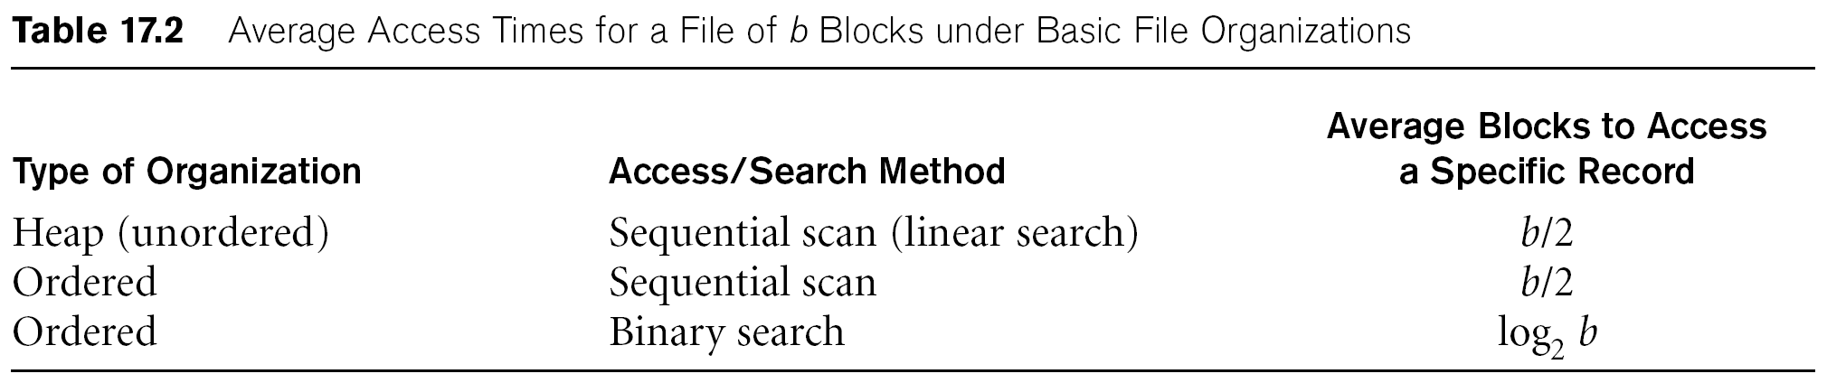
Average Access Times
Each type of file organization represents a certain performance trace-off.
Insertion-intensive applications
Search-intensive applications

Slide 14
Hashed Files
The file are divided into equal-sized buckets.
Typically, a bucket corresponds to one (or a fixed number of) disk block.
We use a hashing function h() and select one table field as the hash key.
The record with hash key value K is stored in bucket i, where i=h(K)
In the file header, we also maintain a bucket to block mapping so we know which bucket maps to which block.

Slide 15
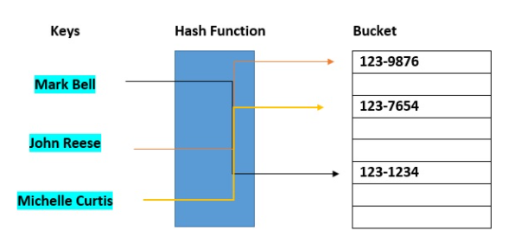
Hashed Files

Slide 16
Hashed Files
Search on the hash key is very efficient. In most cases, I/O cost to search for a record = only one block access.
What if not on hash key?
Hashed files also have their limitation
Collisions occur when a new record hashes to a block that is already full or more than one records hash to the same address

Slide 17
Hashed Files (cont.)
There are numerous methods for collision resolution, including the following:
Open addressing: Proceeding from the occupied position specified by the hash address, the program checks the subsequent positions in order until an unused (empty) position is found.
Chaining: overflow locations are kept. In addition, a pointer field is added to each record location.
Multiple hashing: The program applies a second hash function if the first results in a collision.

Slide 18
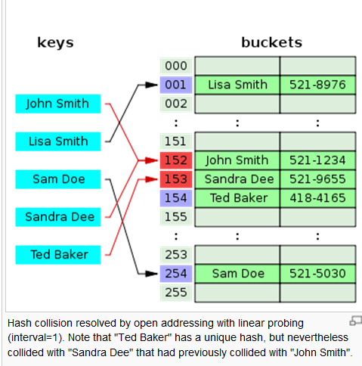
Open addressing

Slide 19
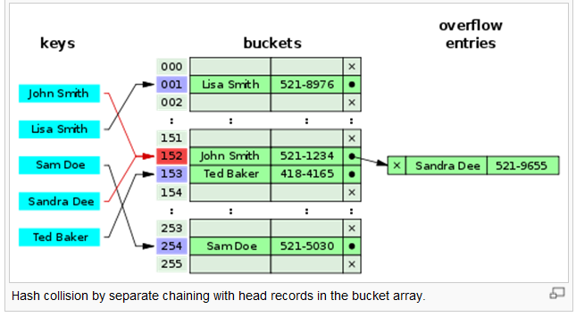
Chaining

Slide 20
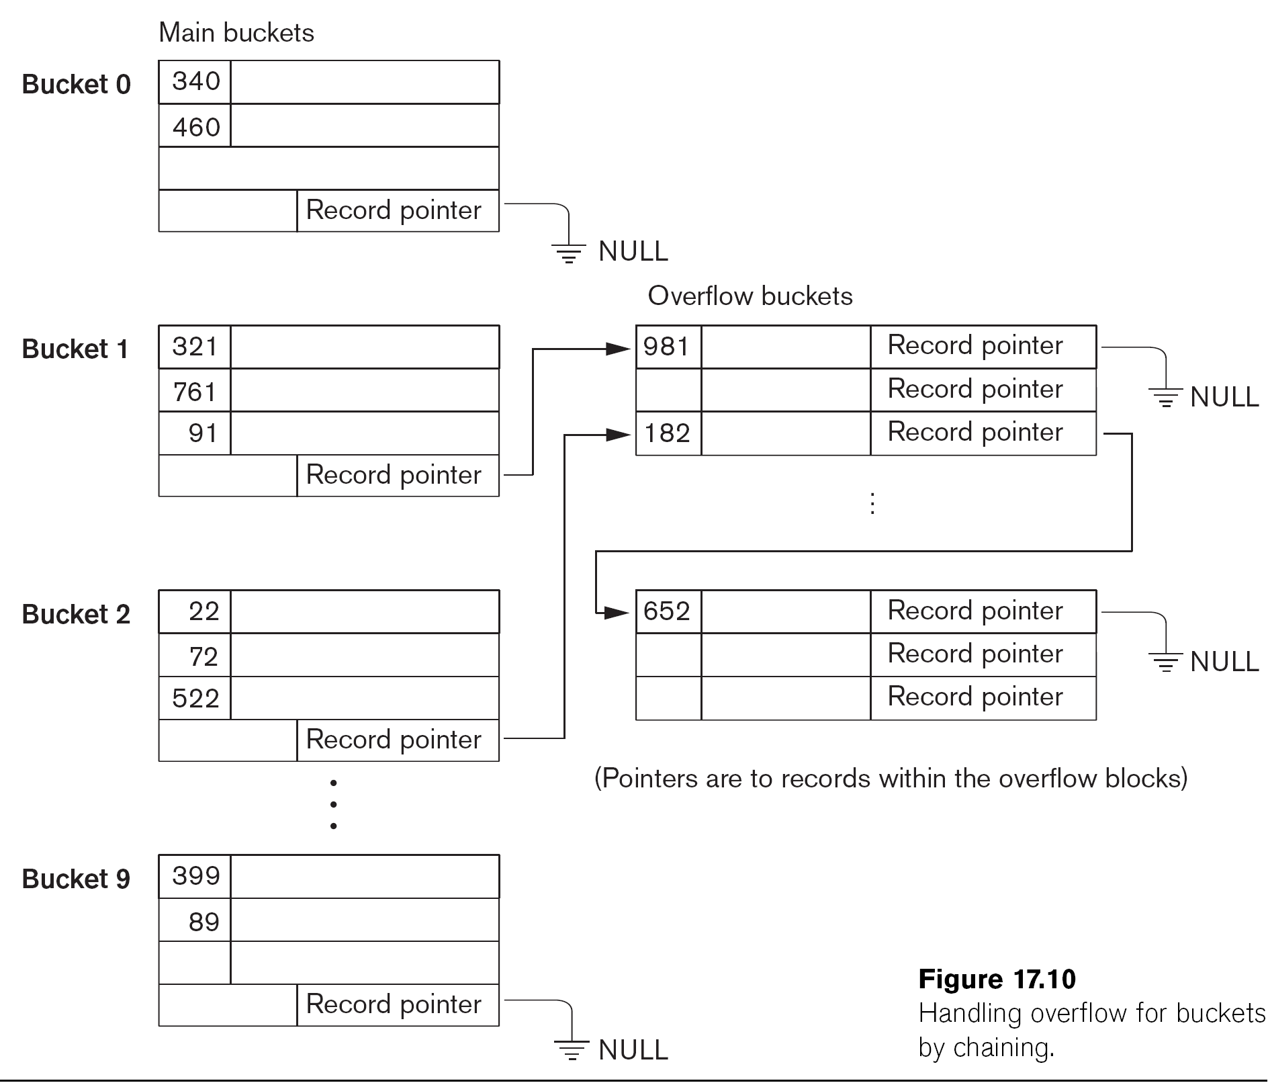
Chaining (multiple overflow buckets)

Slide 21
Hashed Files
For better search performance, two principles of using hashed files:
To reduce collision, a hash file is typically kept 70-80% full.
The desirable hash function should distribute the records uniformly among all the addresses. Otherwise, search time will be increased because many overflow records will exist. In the worse case, cost can degrade to linear search

Slide 22
Parallelizing Disk Access using RAID Technology
RAID stands for Redundant Arrays of Independent Disks,
Two goals of using RAID : (1) improved I/O performance (2) improved reliability
Two techniques of achieving RAID: data stripping and data mirroring

Slide 23
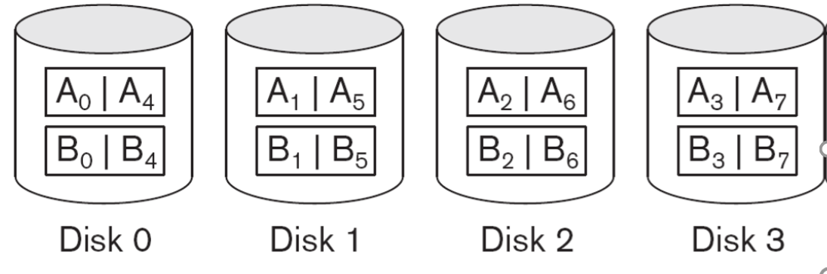
Parallelizing Disk Access using RAID Technology
Data striping distributes data over multiple disks to make them appear as a single large, fast disk.
Data striping allows multiple Read/Write heads to work in parallel

Slide 24
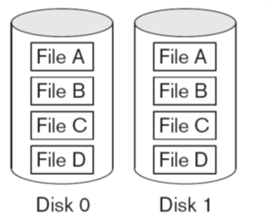
Parallelizing Disk Access using RAID Technology
Data mirroring

Slide 25
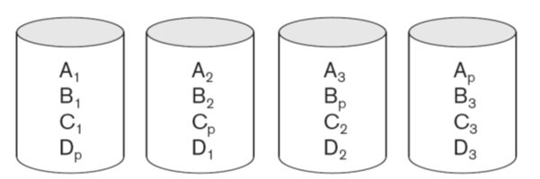
Use of RAID Technology (cont.)
Four most popular RAID levels: Level 0, Level 1, Level 5, and Level 10
RAID level 0 uses data striping only
RAID level 1 uses mirroring only
Raid Level 5 uses data striping and parity blocks across all disks. RAID Level 5 needs an extra disk for parity blocks. The parity block contains an error correction code (e.g., hamming code). Level 5 can recover any single missing block
What if two disks fail?
What is RAID level 10?

Slide 26
Video on RAID

Slide 27
Practice on disk I/O cost
Each block is 0.5 KB. The average seek time is 5ms, the transfer rate is 40MB/sec, it rotates at 10,000 RPM.
1. What is the average time to read/write a file stored in 100 consecutive blocks on the same track on this disk?
2. What if we have 10 such disks and use the data striping technology?

Slide 28
Solution
Disk access time = seek time + average rotation delay + transfer time
Without RAID:
=5ms + (60/10,000RPM)/2 + (0.5*100 KB)/(40MB/sec)
=5ms + 3.0ms + 1.25ms
=9.25ms
With RAID:
=5ms + (60/10,000RPM)/2 + (0.5*(100/10) KB)/(40MB/sec)
=5ms + 3.0ms + 0.125ms
=8.125ms

Slide 29
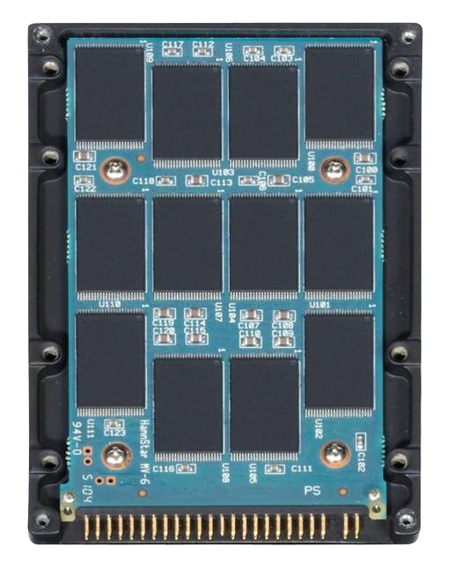
Solid State Disks
≠
SSDs have no mechanical moving parts

Slide 30
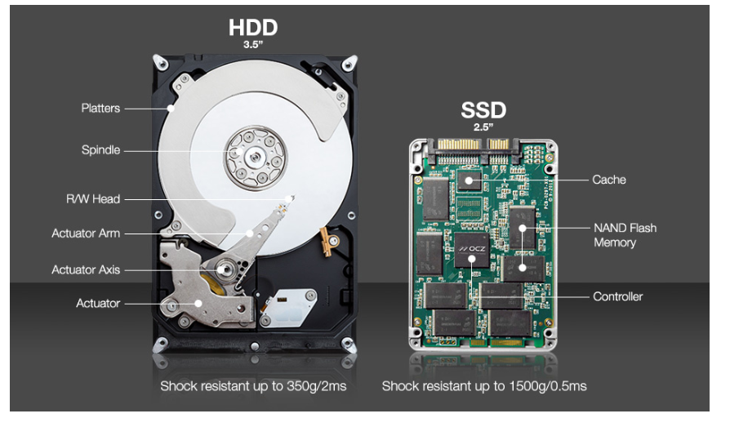
http://www.businesskorea.co.kr/news/articleView.html?idxno=22127
SSD:
Flash based
RAM based… but with build-in battery

Slide 31
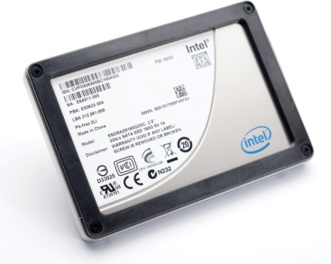
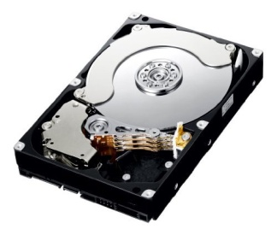
Why Solid State Disks?
Solid State Disks | Hard Disks
Lighter | Heavier
Low Power Cost | Higher Power Cost
Good Shock Resistance | Bad Shock Resistance
Random Access | Sequential Access
More Expensive | Much Cheaper

Slide 32

SSDs have no Mechanical Moving parts (no seek time and rotational delay)
Notes:
Why still suffers random writes

Slide 33
Moving Parts vs. Parallelism
Hard disks
Challenge: Minimize seek time and rotational delay
Data transfer unit: Block (0.5KB – 4KB)
SSDs
Challenge: Maximize number of operations in flight
Data transfer unit: Page (4KB, typically)
Block (128 pages, typically)

